Slide 1
Socio-technical Systems

Slide 2
Objectives
To explain what a socio-technical system is and the distinction between this and a computer-based system
To introduce the concept of emergent system properties such as reliability and security
To explain system engineering and system procurement processes
To explain why the organisational context of a system affects its design and use
To discuss legacy systems and why these are critical to many businesses
解释什么是社会技术系统socio-technical system ，了解基于计算机的纯技术系统和社会技术系统两者之间的区别
介绍系统总体属性的概念,如可靠性和安全性
解释系统工程和系统procurement 过程
解释为什么系统的组织环境 影响其设计和使用
讨论遗留legacy系统 和 为什么遗留系统对于许多企业至关重要

Slide 3
Topics covered
Emergent system properties
Systems engineering
Organizations, people and computer systems
Legacy systems
系统主体属性
系统工程
组织、人员和计算机系统
遗留系统

Slide 4
What is a system?什么是系统
A purposeful collection of inter-related components working together to achieve some common objective.
A system may include software, mechanical, electrical and electronic hardware and be operated by people.
System components are dependent on other system components
The properties and behaviour of system components are inextricably inter-mingled
有目的的相互关联的组件集合，它们共同工作以实现共同的目标。
一个系统可能包括软件、机械、电力和电子硬件和人的操作。
系统组件依赖于其他系统组件
系统组件的属性和行为不可避免地在混合在一起

Slide 5
System categories系统分类
Technical computer-based systems
  Systems that include hardware and software but where the operators and operational processes are not normally considered to be part of the system. The system is not self-aware.
Socio-technical systems
  Systems that include technical systems but also operational processes and people who use and interact with the technical system. Socio-technical systems are governed by organisational policies and rules.
  技术 基于计算机的系统
  系统包括硬件和软件,但操作者和操作流程通常不被看作是系统的一部分。系统没有自我意识~
  社会技术Socio-technical系统
  系统包括 技术系统、操作流程和使用并与技术系统交互的人。社会技术系统是由组织策略和规则支配的。

Slide 6
Socio-technical system characteristics
社会技术系统特点
Emergent properties
  Properties of the system of a whole that depend on the system components and their relationships.
Non-deterministic
  They do not always produce the same output when presented with the same input because the systems’s behaviour is partially dependent on human operators.
Complex relationships with organisational objectives
  The extent to which the system supports organisational objectives does not just depend on the system itself.
  主体属性
  系统的整体属性 依赖系统组件和 它们之间的关系。
  不确定性
  当 面对相同的输入时 他们并不总是产生相同的输出，因为系统的行为部分地依赖于人类的操作者。
  组织目标的复杂关系
  系统支持组织目标 的程度 不仅仅取决于系统本身。

Slide 7
Emergent properties总体属性
Properties of the system as a whole rather than properties that can be derived from the properties of components of a system
Emergent properties are a consequence of the relationships between system components
They can therefore only be assessed and measured once the components have been integrated into a system
系统的属性作为一个整体而不是由系统的组件的属性导出的属性。
主体Emergent属性是系统组件之间的关系 的结果
因此一旦组件被集成到一个系统，他们才可以被评估和测量

Slide 8
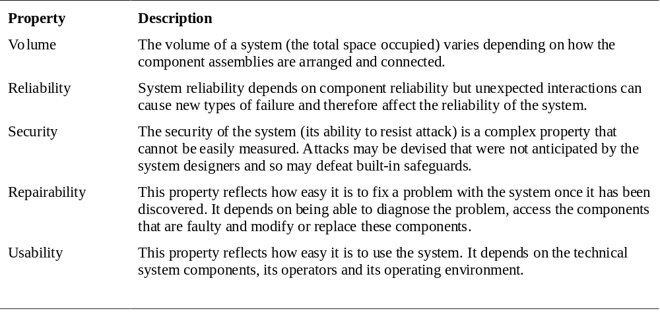
Examples of emergent properties

Slide 9
体积
系统的体积取决于系统组件间是如何安排和连接的
可靠性
系统的可靠性取决于组件的可靠性，但是意料外的相互作用可能引起新类型的失败，因此影响了系统的可靠性
安全性
系统的安全性(抵抗攻击的能力)是一个不能被容易测量的复杂的属性。攻击可能是系统设计者预料不到了，因此可能击败内置的安全措施
可修复性
它影响了一旦系统出了问题，修复它的容易程度。它取决于诊断问题、连接坏了的组件、修改or替换组件的能力。
可用性
影响了系统使用的容易程度，取决于技术系统组件、它的操作者，操作环境。

Slide 10
Types of emergent property类型
Functional properties
  These appear when all the parts of a system work together to achieve some objective. For example, a bicycle has the functional property of being a transportation device once it has been assembled from its components.
Non-functional emergent properties
  Examples are reliability, performance, safety, and security. These relate to the behaviour of the system in its operational environment. They are often critical for computer-based systems as failure to achieve some minimal defined level in these properties may make the system unusable.
  功能特性
  这些出现在 系统的所有部分一起工作 来实现一些目标。例如,一辆自行车一旦被从组件组装在起来，其功能属性就是作为一个交通工具。
  非功能性的总体特性
  例子-可靠性、性能、安全和保障。这些关系到系统在操作环境中的行为。他们通常因为基于计算机的系统未能实现一些最小水平定义水平 而危险，这些属性可能使系统无法使用。

Slide 11
System reliability engineering
系统可靠性工程
Because of component inter-dependencies, faults can be propagated through the system.
System failures often occur because of unforeseen inter-relationships between components.
It is probably impossible to anticipate all possible component relationships.
Software reliability measures may give a false picture of the system reliability.
因为组件间相互依赖关系,故障可以通过系统来传播。
系统故障经常发生,因为不可预见的组件之间的相互关系。
不可能预见到所有可能的组件之间的关系。
软件可靠性措施可能给系统的可靠性一个虚假的表象。

Slide 12
Influences on reliability对可靠性的影响
Hardware reliability
  What is the probability of a hardware component failing and how long does it take to repair that component?
Software reliability
  How likely is it that a software component will produce an incorrect output. Software failure is usually distinct from hardware failure in that software does not wear out.
Operator reliability
  How likely is it that the operator of a system will make an error?
  硬件可靠性
  什么是硬件组件失败的可能性，修复该组件需要多长时间?
  软件可靠性
  软件组件如何产生一个不正确的输出。软件故障和硬件故障通常是不同的，软件不会磨损。
  操作者的可靠性
  操作系统者出错的可能性有多大?

Slide 13
Reliability relationships可靠性的关系
Hardware failure can generate spurious signals that are outside the range of inputs expected by the software.
Software errors can cause alarms to be activated which cause operator stress and lead to operator errors.
The environment in which a system is installed can affect its reliability.
硬件故障可以产生 被软件期望的输入范围之外 的虚假信号。
软件错误可以导致警报被激活 以至于给了操作员压力,而导致错误。
系统的安装环境会影响其可靠性。

Slide 14
The ‘shall-not’ properties
不应该的属性
Properties such as performance and reliability can be measured.
However, some properties are properties that the system should not exhibit
  Safety - the system should not behave in an unsafe way;
  Security - the system should not permit unauthorised use.
Measuring or assessing these properties is very hard.
属性是可以测量的，例如性能和可靠性
然而,一些属性是系统不应该展示的属性
  Safety - 系统不应有一个不安全的行为方式;
  Security -系统不允许未经授权的使用。
测量或评估这些属性是非常困难的。

Slide 15
Systems engineering系统工程
Specifying, designing, implementing, validating, deploying and maintaining socio-technical systems.
Concerned with the services provided by the system, constraints on its construction and operation and the ways in which it is used.
说明、设计、实现、验证、部署和维护socio-technical系统。
关心系统提供的服务,限制其建设和运营以及使用它的方式。

Slide 16
The system engineering process
系统工程流程
Usually follows a ‘waterfall’ model because of the need for parallel development of different parts of the system
  Little scope for iteration between phases because hardware changes are very expensive. Software may have to compensate for hardware problems.
Inevitably involves engineers from different disciplines who must work together
  Much scope for misunderstanding here. Different disciplines use a different vocabulary and much negotiation is required. Engineers may have personal agendas to fulfil.
  通常遵循“瀑布式”模式,因为系统的不同部分需要并行开发
  阶段之间需要小范围的迭代,因为硬件变化是非常昂贵的。软件可能需要弥补硬件问题。
  不可避免地 来自不同学科的工程师必须一起工作
  大范围的误会是。不同学科使用不同的词汇 而且谈判是必需的。工程师们可能有个人议程要完成。

Slide 17
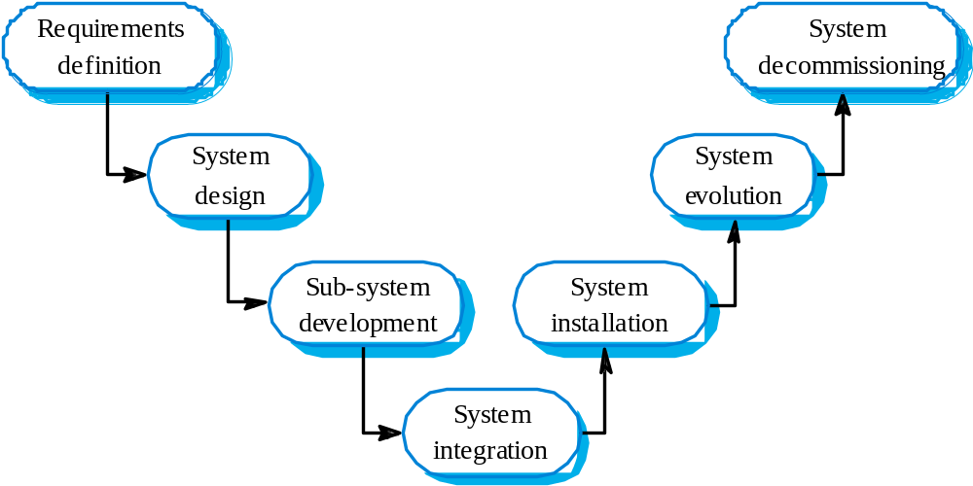
The systems engineering process
系统工程流程

Slide 18
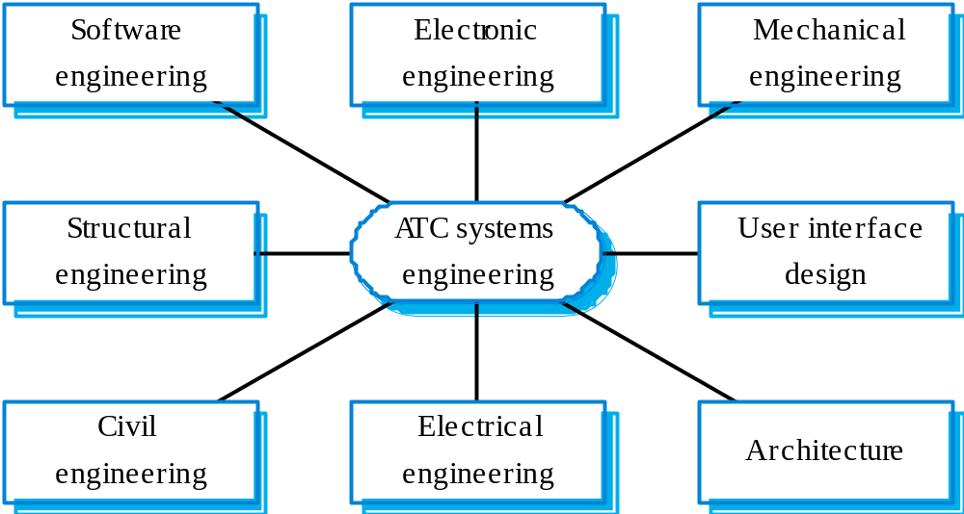
Inter-disciplinary involvement
跨学科的参与

Slide 19
System requirements definition
系统需求定义
Three types of requirement defined at this stage
  Abstract functional requirements. System functions are defined in an abstract way;
  System properties. Non-functional requirements for the system in general are defined;
  Undesirable characteristics. Unacceptable system behaviour is specified.
Should also define overall organisational objectives for the system.
这个阶段的 三种类型的需求定义
  抽象的功能需求---系统功能以一种抽象的方式定义;
  系统属性---系统的非功能性需求通常已经定义;
  不合需要的特点---不可接受的系统行为被指定。
还应该 为 系统定义 整个组织目标。

Slide 20
系统目标
Should define why a system is being procured for a particular environment.
Functional objectives
  To provide a fire and intruder alarm system for the building which will provide internal and external warning of fire or unauthorized intrusion.
Organisational objectives
  To ensure that the normal functioning of work carried out in the building is not seriously disrupted by events such as fire and unauthorized intrusion.
  应该为特定的环境定义为什么系统要采购。
  功能目标
  提供防火和防盗警报系统，这样将提供内部和外部的建筑火灾的预警 或 未经授权的入侵。
  组织的目标
  以确保工作的正常功能的进行，不是被严重事件中断,如火灾和未经授权的入侵。

Slide 21
System requirements problems
系统需求问题
Complex systems are usually developed to address wicked problems
  Problems that are not fully understood;
  Changing as the system is being specified.
Must anticipate hardware/communications
developments over the lifetime of the system.
Hard to define non-functional requirements
(particularly) without knowing the
component structure of the system.
复杂系统通常用来解决恶劣的问题
  问题不完全理解;
  随着系统的指定 而改变。
必须预测系统的生命周期的 硬件/通信 发展。
很难定义非功能性需求(特别是)在不知道系统的组件结构的时候。

Slide 22
The system design process
系统设计流程
Partition requirements
  Organise requirements into related groups.
Identify sub-systems
  Identify a set of sub-systems which collectively can meet the system requirements.
Assign requirements to sub-systems
  Causes particular problems when COTS are integrated.
Specify sub-system functionality.
Define sub-system interfaces
  Critical activity for parallel sub-system development.
  区分需求
  将需求 组织分成相关的组。
  识别子系统
  确定一组子系统 可以大体上满足系统的要求。
  将需求分配给子系统
  COTS集成时导致特定的问题。
  指定子系统的功能
  定义子系统接口
  并行子系统开发 的 关键活动。

Slide 23
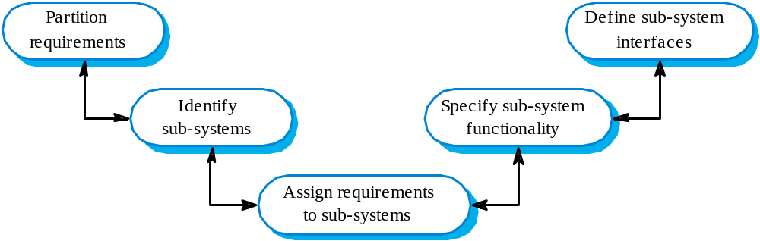
The system design process

Slide 24
System design problems
系统设计问题
Requirements partitioning to hardware,
software and human components may involve a lot of negotiation.
Difficult design problems are often assumed to be readily solved using software.
Hardware platforms may be inappropriate for
software requirements so software must compensate for this.
需求划分硬件、软件和人力组件 可能包括大量的谈判。
困难的设计问题通常被认为是使用软件容易解决。
硬件平台可能不适合软件需求,软件必须弥补这一点。

Slide 25
Requirements and design
Requirements engineering and system design are inextricably linked.
Constraints posed by the system’s environment and other systems limit design choices so the actual design to be used may be a requirement.
Initial design may be necessary to structure the requirements.
As you do design, you learn more about the requirements.
需求工程和系统设计不可避免的联系着。
受系统环境的约束以及其他系统限制的设计选择 所以the actual design to be used may be a requirement.
初步的设计对需求的构建是必要的
在你设计的过程中，你学到了更多关于需求的东西

Slide 26
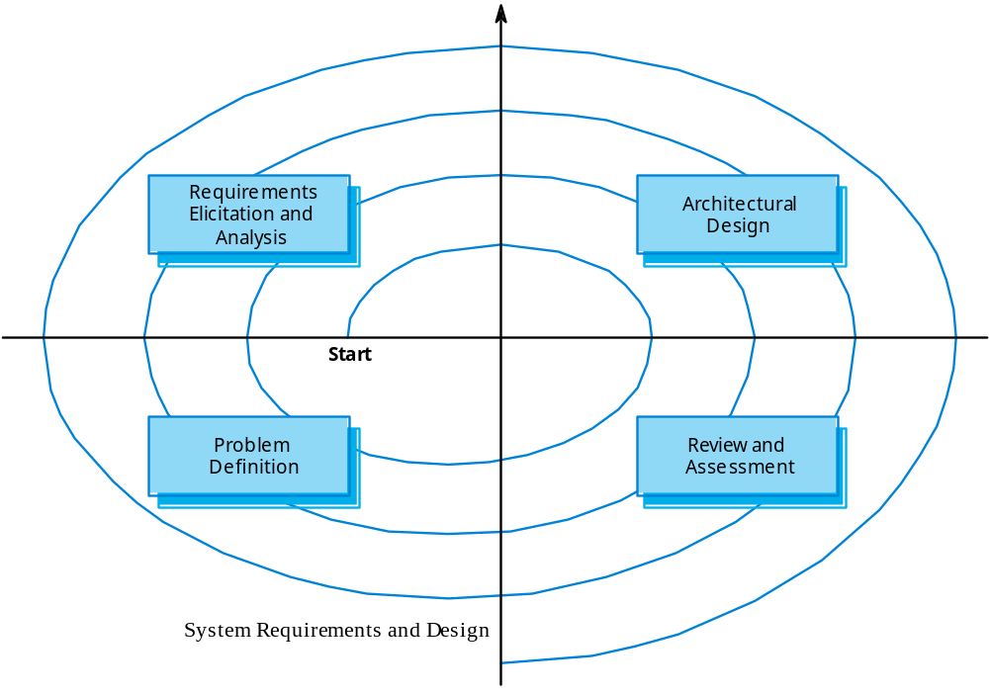
Spiral model of requirements/design
螺旋模型的需求/设计

Slide 27
System modelling系统模型
An architectural model presents an abstract view of the sub-systems making up a system
May include major information flows between sub-systems
Usually presented as a block diagram
May identify different types of functional component in the model
An architectural model presents an abstract view of the sub-systems making up a system
可以包括子系统之间的主要信息流动
通常表示为一个框图
可以识别模型中的不同类型的功能组件

Slide 28
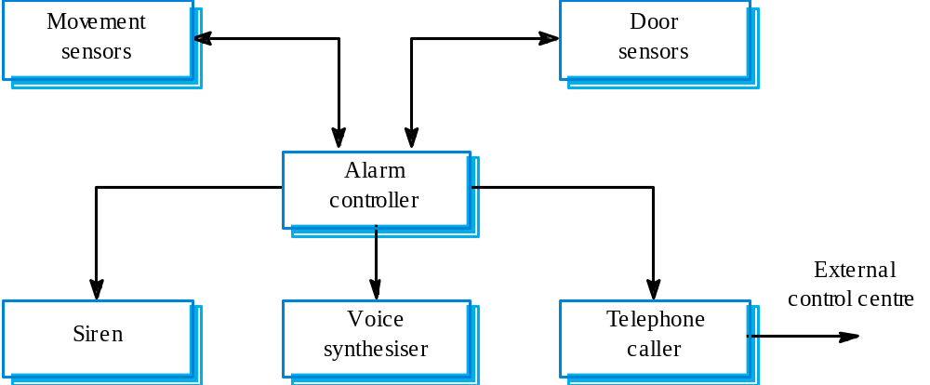
Burglar alarm system防盗报警系统

Slide 29
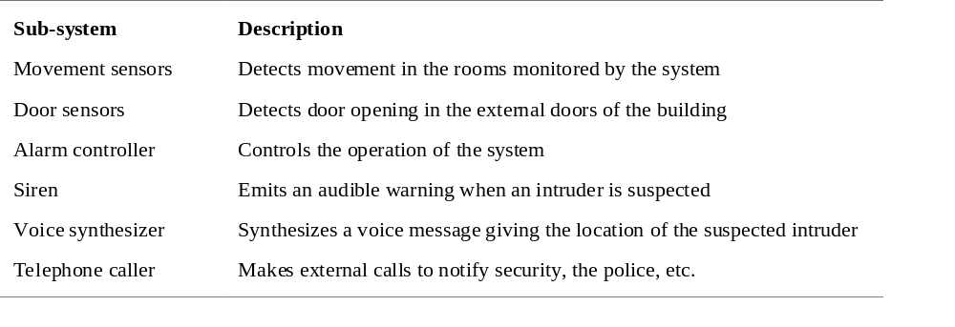
Sub-system description子系统描述

Slide 30
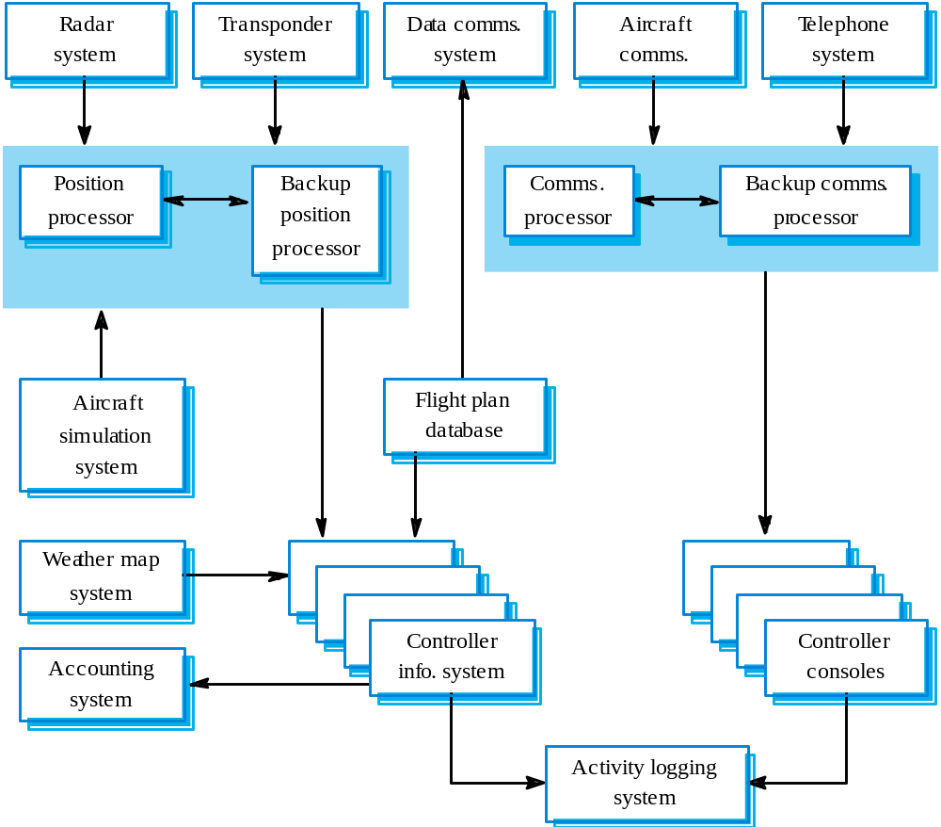
ATC system architecture 系统架构

Slide 31
Sub-system development子系统开发
Typically parallel projects developing the
hardware, software and communications.
May involve some COTS (Commercial Off-the-Shelf) systems procurement.
Lack of communication across implementation
teams.
Bureaucratic and slow mechanism for
proposing system changes means that the development schedule may be extended because of the need for rework.
通常并行项目开发硬件、软件和通信。
可能涉及一些COTS(商用现货)系统采购procurement 。
实现团队间缺乏沟通。
官僚和缓慢的机制提出系统的变化，意味着开发进度可能会延长,因为需要返工。

Slide 32
System integration系统集成
The process of putting hardware, software and
people together to make a system.
Should be tackled incrementally so that sub-systems are integrated one at a time.
Interface problems between sub-systems are usually found at this stage.
May be problems with uncoordinated deliveries of system components.
将硬件、软件和人一起做一个系统的过程
应该逐步解决 将子系统同时集成。
子系统之间的接口问题通常是发现在这个阶段。
系统组件不协调的交付也是一个问题

Slide 33
System installation系统安装
After completion, the system has to be installed in the customer’s environment
  Environmental assumptions may be incorrect;
  May be human resistance to the introduction of a new system;
  System may have to coexist with alternative systems for some time;
  May be physical installation problems (e.g. cabling problems);
  Operator training has to be identified
  完成后,系统必须安装在客户的环境
  环境的假设可能是错误的;
  可能是人类阻碍了引入新系统;
  系统可能与替代系统共存一段时间;
  可能是物理安装问题(例如布线问题);
  操作者应该培训。

Slide 34
System evolution系统进化
Large systems have a long lifetime. They must evolve to meet changing requirements.
Evolution is inherently costly
  Changes must be analysed from a technical and business perspective;
  Sub-systems interact so unanticipated problems can arise;
  There is rarely a rationale for original design decisions;
  System structure is corrupted as changes are made to it.
Existing systems which must be maintained are sometimes called legacy systems.
大型系统有一个长寿命。他们必须发展,以满足不断变化的需求。
进化本质上是昂贵的
  改变必须从技术和业务的角度分析;
  子系统交互,所以会出现意料之外的问题;
  很少有原始设计决策的理论基础;
  系统结构在更改它被损坏。
  现有系统必须保持有时也被称作遗留系统。

Slide 35
System decommissioning系统退役
Taking the system out of service after its useful lifetime.
May require removal of materials (e.g. dangerous chemicals) which pollute the environment
  Should be planned for in the system design by encapsulation.
May require data to be restructured and converted to be used in some other system.
系统用完后 要 将其从服务中去掉。
可能需要去除的污染环境的材料(如危险化学品)
  应该计划 系统中用封装来设计。
可能需要重组数据并转换为用于其他系统。

Slide 36
Organisations/people/systems
组织/ 人 /系统
Socio-technical systems are organisational systems intended to help deliver some organisational or business goal.
If you do not understand the organisational environment where a system is used, the system is less likely to meet the real needs of the business and its users.
社会技术系统是组织系统，旨在帮助提供一些组织或业务目标。
如果在使用一个系统时你不理解其组织环境,该系统不太可能满足业务和用户的实际需求。

Slide 37
Human and organisational factors
人类和组织因素
Process changes
  Does the system require changes to the work processes in the environment?
Job changes
  Does the system de-skill the users in an environment or cause them to change the way they work?
Organisational changes
  Does the system change the political power structure in an organisation?
  过程变化
  系统是否需要改变环境中的工作流程?
  工作变动
  系统使用户在一个环境丧失专业技能，或使他们改变他们的工作方式?
  组织的变化
  系统改变一个组织的 political power structure?

Slide 38
Organisational processes组织流程
The processes of systems engineering overlap and interact with organisational procurement processes.
Operational processes are the processes involved in using the system for its intended purpose. For new systems, these have to be defined as part of the system design.
Operational processes should be designed to be flexible and should not force operations to be done in a particular way. It is important that human operators can use their initiative if problems arise.
系统工程的流程 与 组织采购流程 重叠、交互。
Operational processes are the processes involved in using the system for its intended purpose. 。对于新系统,这些必须被定义为系统设计的一部分。
操作流程应该设计得灵活,不应强迫其在一个特定的方式进行。重要的是操作员在出现问题时可以发挥他们的自主性。

Slide 39
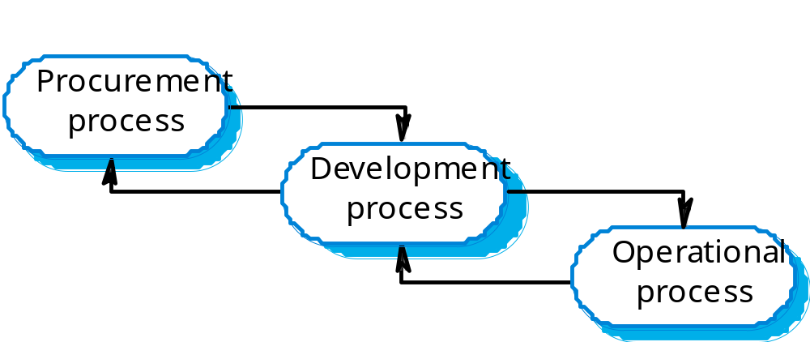
Procurement/development processes
采购/开发过程

Slide 40
System procurement系统采购
Acquiring a system for an organization to meet some need
Some system specification and architectural design is usually necessary before procurement
  You need a specification to let a contract for system development
  The specification may allow you to buy a commercial off-the-shelf (COTS) system. Almost always cheaper than developing a system from scratch
Large complex systems usually consist of a mix of off the shelf and specially designed components. The procurement processes for these different types of component are usually different.
为了组织的系统 满足一些需求
采购之前 的 系统规范和架构设计 通常是必要的
  你需要一个规范系统开发合同
  规范可能允许你购买商用现货(COTS)系统。几乎总是比从头开始开发一个系统便宜
大型复杂系统通常由一个现成的和特别设计的组件。这些不同类型的组件的采购流程通常是不同的。

Slide 41
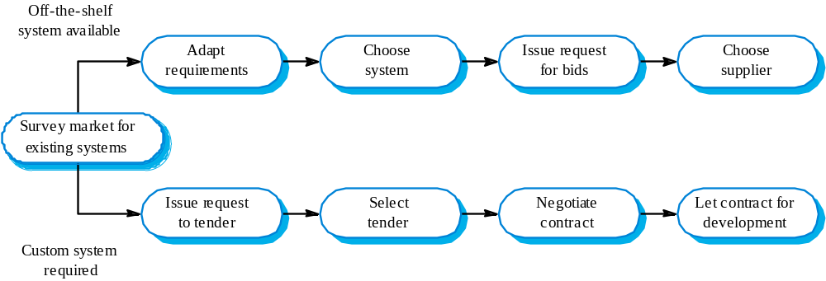
The system procurement process
系统采购流程

Slide 42
Procurement issues采购问题
Requirements may have to be modified to match the capabilities of off-the-shelf components.
The requirements specification may be part of the contract for the development of the system.
There is usually a contract negotiation period to agree changes after the contractor to build a system has been selected.
需求可能不得不修改 以匹配现成的组件的功能。
系统开发过程中，需求规范可能是合同的一部分。
通常在承包商选择建立系统后， contract negotiation period to agree changes 。

Slide 43
Contractors and sub-contractors
承包商和分包商
The procurement of large hardware/software systems is usually based around some principal contractor.
Sub-contracts are issued to other suppliers to supply parts of the system.
Customer liases with the principal contractor and does not deal directly with sub-contractors.
大型硬件/软件的采购系统通常是基于一些主要承包商。
分包合同,发给其他供应商供应的部分系统。
客户联络主要承包商,不直接联系分包商。

Slide 44
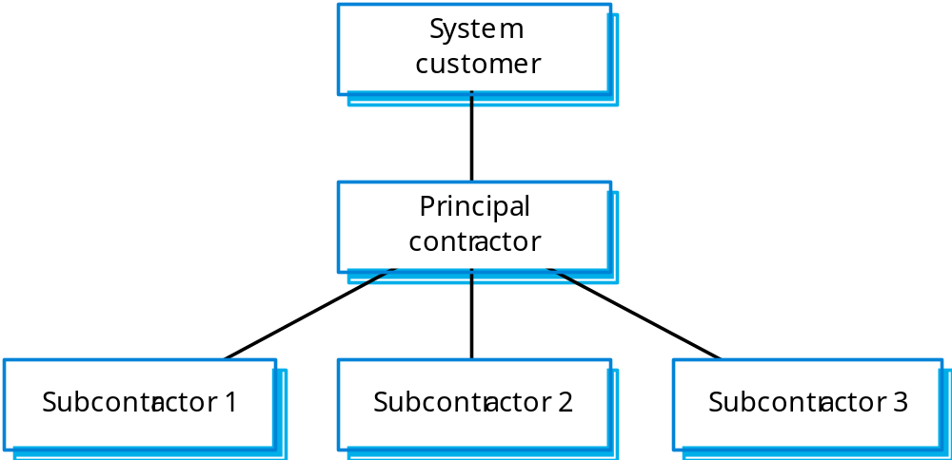
Contractor/Sub-contractor model
承包商/分包商模型

Slide 45
Legacy systems遗留系统
Socio-technical systems that have been developed using old or obsolete technology.
Crucial to the operation of a business and it is often too risky to discard these systems
  Bank customer accounting system;
  Aircraft maintenance system.
Legacy systems constrain new business processes and consume a high proportion of company budgets.
社会技术系统已经开发出来,它使用旧的或过时的技术。
社会技术系统都是关键的操作业务，丢弃这些系统往往是风险太大
  银行客户会计系统;
  飞机维修系统。
遗留系统限制新的业务流程 在预算方面消耗比较高。

Slide 46
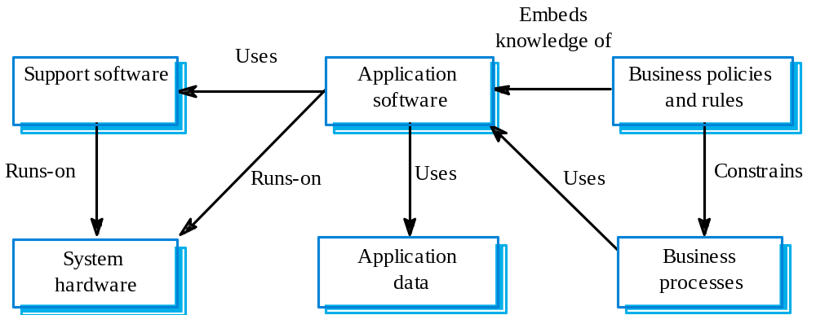

Slide 47
Legacy system components
遗留系统组件
Hardware - may be obsolete mainframe hardware.
Support software - may rely on support software from suppliers who are no longer in business.
Application software - may be written in obsolete programming languages.
Application data - often incomplete and inconsistent.
Business processes - may be constrained by software structure and functionality.
Business policies and rules - may be implicit and embedded in the system software.
硬件——可能是过时的大型主机硬件。
支持软件——可能依赖于供应商的支持软件，这些供应商不再经商了。
应用软件——可能是过时的编程语言编写的。
应用程序数据——通常是不完整的和不一致的。
业务流程——可能受到软件结构和功能制约。
业务策略和规则——可能是隐式和嵌入式系统软件。

Slide 48
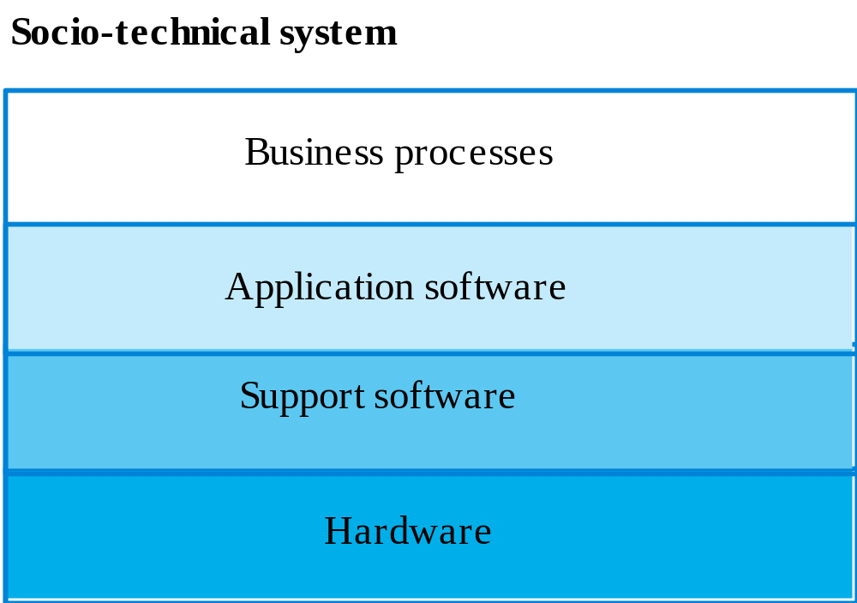
社会技术系统

Slide 49
Key points
Socio-technical systems include computer hardware, software and people and are designed to meet some business goal.
Emergent properties are properties that are characteristic of the system as a whole and not its component parts.
The systems engineering process includes specification, design, development, integration and testing. System integration is particularly critical.
社会技术的系统包括计算机硬件、软件和人,是为了满足一些业务目标。
主体属性，指系统作为一个整体,而不是它的组成部分的属性特征。
系统工程过程包括规范、设计、开发、集成和测试。系统集成是特别至关重要的。

Slide 50
Key points
Human and organisational factors have a significant effect on the operation of socio-technical systems.
There are complex interactions between the processes of system procurement, development and operation.
A legacy system is an old system that continues to provide essential services.
Legacy systems include business processes, application software, support software and system hardware.
人力和组织因素显著影响socio-technical的操作系统。
系统采购、开发和运营的过程之间存在复杂的相互作用。
遗留系统是一个古老的制度,继续提供基本服务。
遗留系统包括业务流程、应用软件、硬件和系统软件的支持。

